Slide 1
MOTHER BOARD
Presented by:- JAF/IT/2019/F/0026
JAF/IT/2019/F/0027
JAF/IT/2019/F/0028
JAF/IT/2019/F/0029
JAF/IT/2019/F/0030

Slide 2
Introduction for computer motherboard
>The first motherboard originally called a ‘PLANNAR’ was used in the IBM personal computer released in 1981.
>If the CPU considered the brain of the computer then the motherboard would certainly have to be the heart of the of any computer.
>It’s that flat ,square plastic board inside the computer with printed circuit chips,connectors and expansion slots on it.
>Every component directly or indirectly involved with making the PC function properly,is attacted, or connected to the motherboard.
>For all intents and purposes,the mothboard is the computer.
>It is an electronic printed circuit board that is the foundation of a computer.
>It is used to interconnect all hardware componets together.
>connectors on the mother.

Slide 3
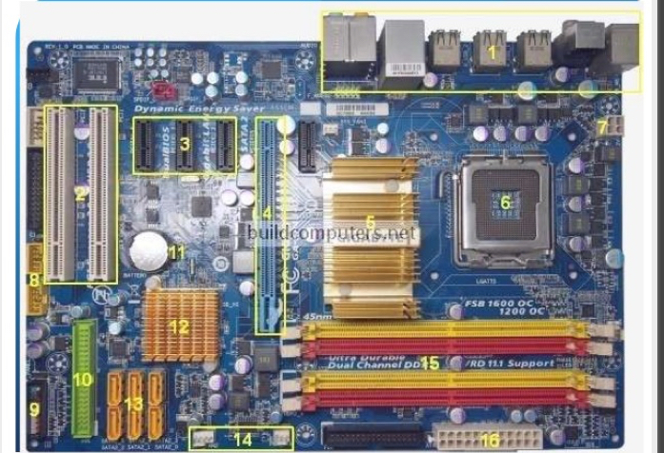

Slide 4
TYPE OF MOTHERBOARD
>INTEGRATED MOTHERBOARD
>NON INTEGRATED MOTHERBOARD
>DESKKTOP MOTHERBOARD
>LAPTOP MOTHERBOARD
>SERVER MOTHERBOARD
>AT MOTHERBOARD
>ATX MOTHERBOARD

Slide 5
TYPE OF MOTHERBOARD
BASED ON FORM FACTOR
AT
ATX
Mini-ATX
Micro-ATX
5. LPX
6. BTX
SEE MORE……..

Slide 6
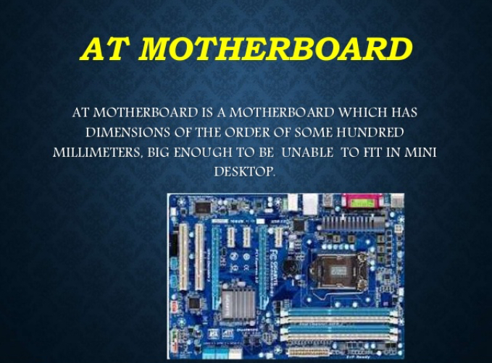

Slide 7
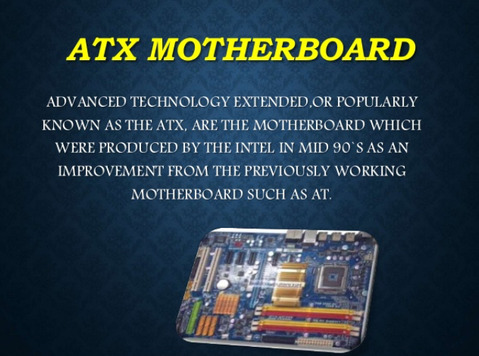

Slide 8
TYPES MOTHERBOARD
BASED ON USE
1.

